Slide 1
Introductory Statistics with R/Python
Part 1: Review & T-Tests

Slide 2
Our Goals
We can use R/Python and other coding languages to analyze data in lots of different ways!
Today we’ll review the basics of some statistical tests and how to implement them in these two languages
We’ll start together as a group going through what each test does (how does it work? when would I use it?) and then split up into breakout rooms to learn to implement them in either R or Python

Slide 3
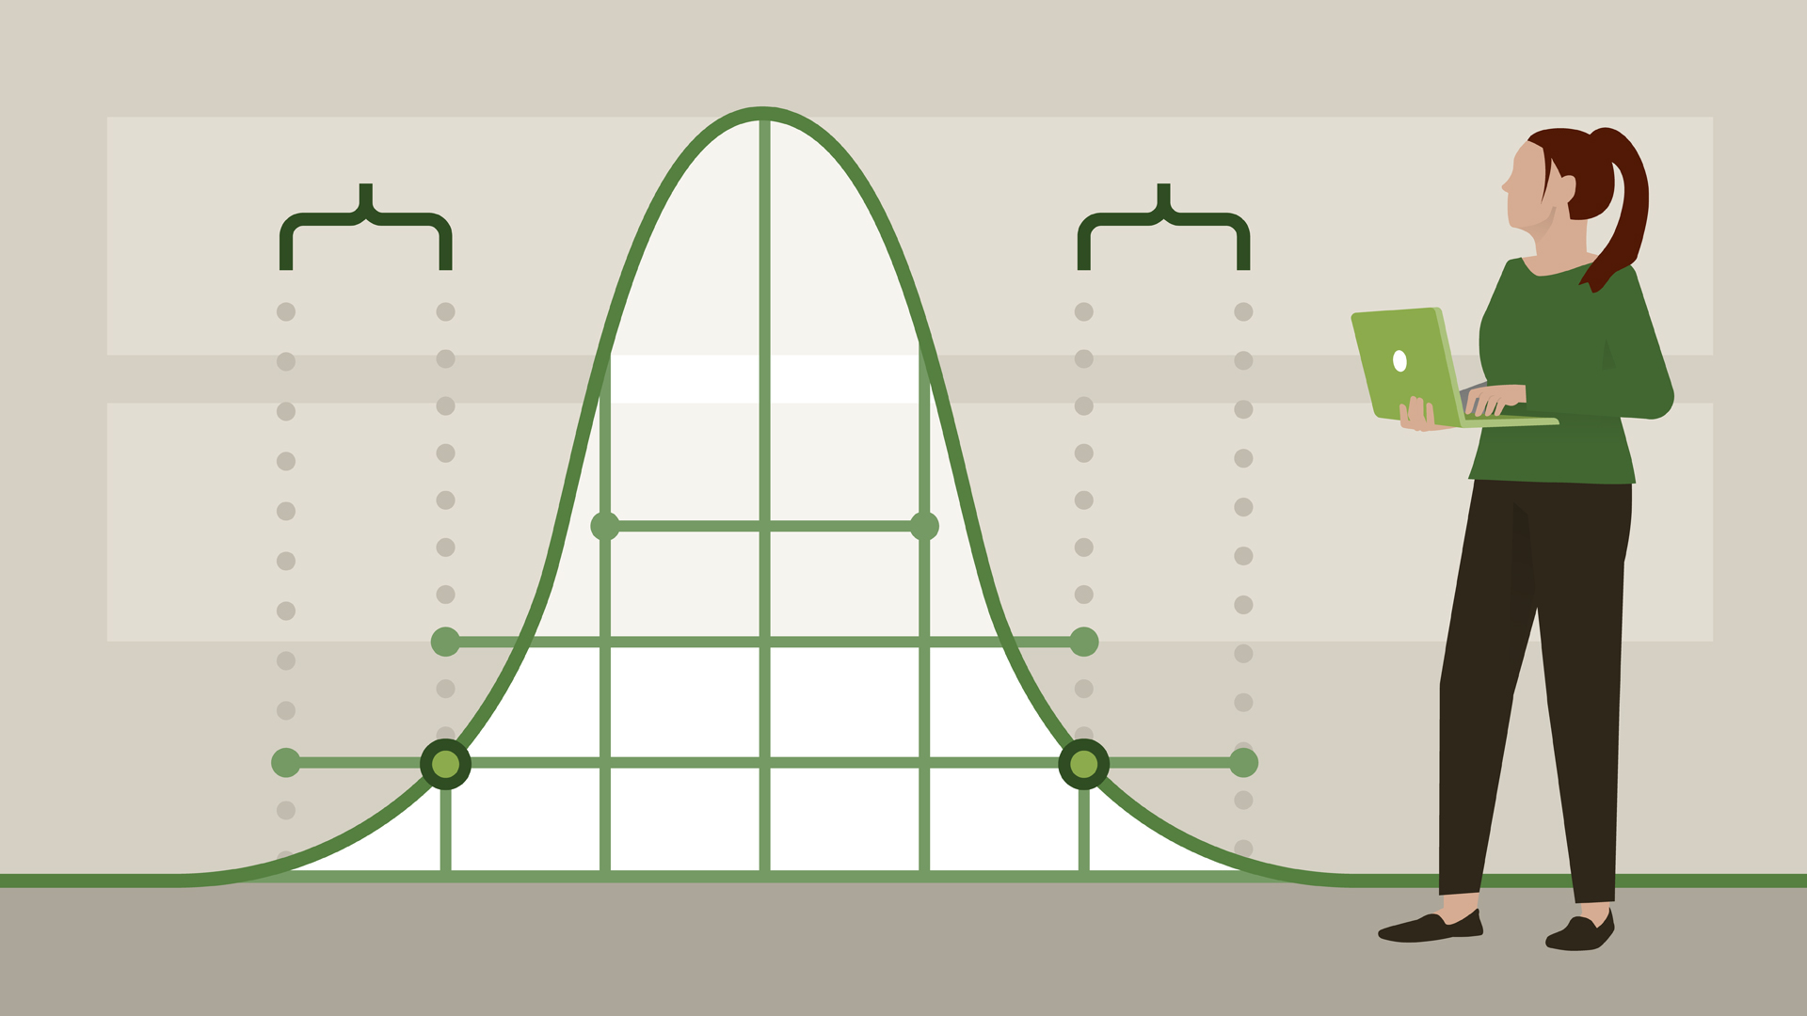

Outline
Review: Data wrangling
Manipulating dataframes
Plotting with ggplot
Creating factors from continuous variables
Part 1: t-tests
Are voters of one party younger or older than voters of another party?
Are Democrats more optimistic than Republicans?
Part 2: Correlation + Linear Regression
What is the relationship between age and optimism?
Multiple linear regression: how do age and party affiliation contribute to optimism?
Part 3: Logistic Regression + Cross-Validation
Can we use information about age and optimism to predict party affiliation?
Practice: Stroop data
Plotting with ggplot: Visualize the data
t-test: Does reaction time differ between congruent and incongruent conditions?
correlation (with practice using pipes!): Is accuracy associated with reaction time on this task?
linear regression: What factors are associated with reaction time?
logistic regression: What factors are associated with correct responses?

Slide 4
Review: Data Wrangling

Slide 5
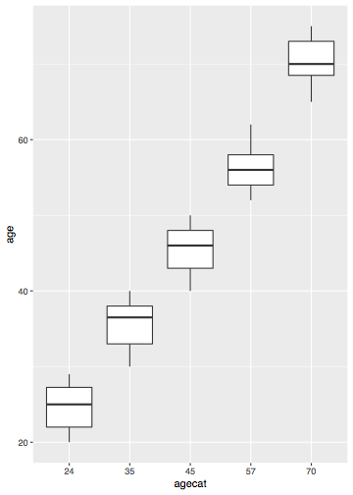
Converting variables from continuous to categorical and plotting
Age might be given to us as a continuous variable, but suppose we want to group participants into age categories
df_survey$agecat0 = findInterval(df_survey$age,
c(29,39,49,65))
df_survey$agecat0 = factor(df_survey$agecat0)

Slide 6
Review: Hypothesis Testing

Slide 7

Shaken or Stirred?
James Bond insists that martinis should be shaken rather than stirred.
Let's consider a hypothetical experiment to determine whether Mr. Bond can tell the difference between a shaken and a stirred martini.

Slide 8

Shaken or Stirred?
We’ll give Mr. Bond a series of 16 taste tests. In each test, we’ll flip a fair coin to determine whether to stir or shake the martini. Then we’ll present the martini to Mr. Bond and ask him to decide whether it was shaken or stirred.
Let's say Mr. Bond was correct on 13 of the 16 taste tests. Does this prove that Mr. Bond has at least some ability to tell whether the martini was shaken or stirred?

Slide 9
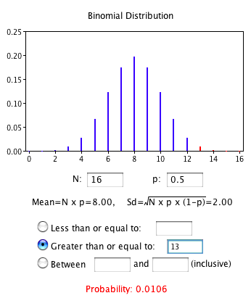
Shaken or Stirred?
This result does not prove that he does; it could be he was just lucky and guessed right 13 out of 16 times. But how plausible is the explanation that he was just lucky?
To assess its plausibility, we determine the probability that someone who was just guessing would be correct 13/16 times or more. This probability can be computed from the binomial distribution, and the binomial distribution calculator shows it to be 0.0106. This is a pretty low probability, and therefore someone would have to be very lucky to be correct 13 or more times out of 16 if they were just guessing.

Slide 10

Shaken or Stirred?
So either Mr. Bond was very lucky, or he can tell whether the drink was shaken or stirred. The hypothesis that he was guessing is not proven false, but considerable doubt is cast on it. Therefore, there is strong evidence that Mr. Bond can tell whether a drink was shaken or stirred.

Slide 11
H₀ vs. H₁
In this example, the “null hypothesis” denoted H₀ was that James Bond was just guessing and getting lucky. The “alternative hypothesis” denoted H₁ was that James Bond really did have some ability to detect the difference between shaken and stirred martinis, above what would be expected by chance.
In general, the null hypothesis is the conclusion that a given effect is due simply to chance. If we have enough evidence to reject the null hypothesis (ie., suggesting that some effect is not likely due to chance) then we can go with the alternative hypothesis. Remember that rejecting H₀ is not undeniable “proof” for H₁.

Slide 12
Part 1: t-tests
(review)

Slide 13
What are we testing with a one-sample t-test?
example: does a group of respondents have a strong preference on this scale, or do they not have a strong preference?
Lower ratings
Higher ratings
0

Slide 14
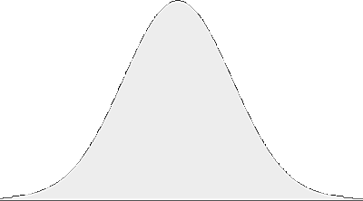
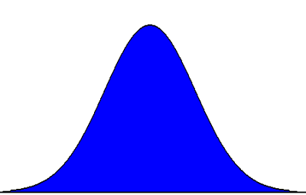
What are we testing with a one-sample t-test?
example: does a group of respondents have a strong preference on this scale, or do they not have a strong preference?
0
0

Slide 15
What are we testing with a one-sample t-test?
example: does a group of respondents have a strong preference on this scale, or do they not have a strong preference?
0
high t value
likely significant
0
low t value
likely non-significant

Slide 16
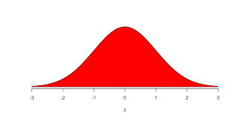
What are we testing with a two-sample t-test?
example: do responses to this question differ between groups of participants?

Slide 17
What are we testing with a two-sample t-test?
example: do responses to this question differ between groups of participants?
high t value
likely significant
low t value
likely non-significant

Slide 18
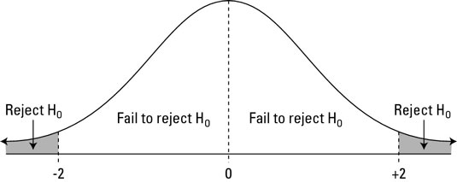
Are two samples drawn from the same distribution or different distributions?
We use the alpha level (e.g., .05) to set our threshold for when to say two sample distributions are likely drawn from the same or different population distributions
area of overlap

Slide 19
R: t.test()
t.test(x, alternative=c(“two.sided”, “less”, “greater”), mu=0) x is a vector of values mu is the population mean (μ) if H₀ is true alternative specifies whether to perform a two- or one-tailed test

Slide 20
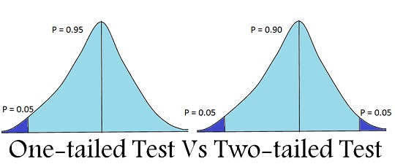
R: t.test()
t.test(x, alternative=c(“two.sided”, “less”, “greater”), mu=0) x is a vector of values mu is the population mean (μ) if H₀ is true alternative specifies whether to perform a two- or one-tailed test
Remember! two-tailed is different from two-sample

Slide 21
R: t.test()
t.test(c(2, 3, 2, 2, 1, 4, 3, 2), alternative=c(‘greater’), mu=0)
This asks whether our vector of numbers is significantly above 0 [one-sample t-test]
t.test(c(2, 3, 2, 2, 1, 4, 3, 2),c(4, 3, 6, 4, 2, 2, 3, 5))
This asks whether our two vectors of numbers are significantly different from one another (ie., are these numbers most likely drawn from different distributions or the same distribution?)
[two-sample t-test]

Slide 22
Try it yourself!
Dataset: ages and party affiliations of registered voters
Q1: Are voters of one party older than voters of another party?
Q2: Are Democrats more optimistic than Republicans?
age
optimism

Slide 23
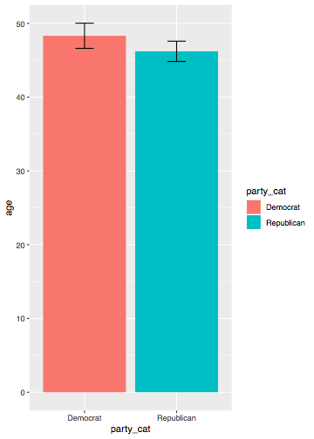
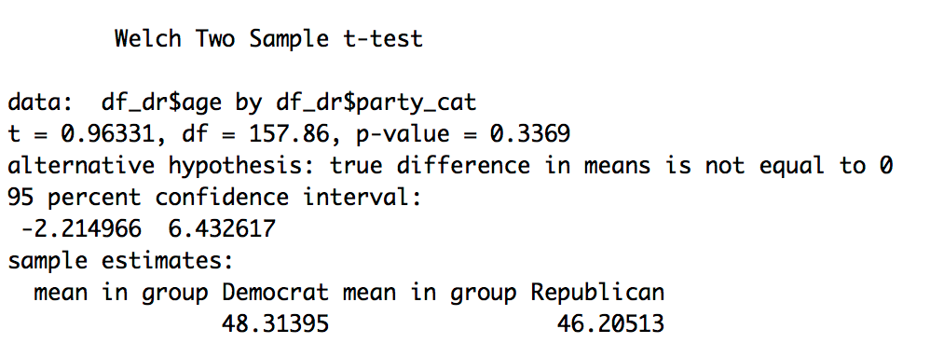
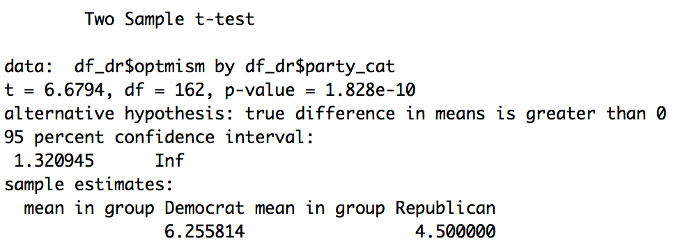
What did you find?
Q1:
Q2:

